Slide 1
ATELIER 2
KHALLIL BOURAS

Slide 2
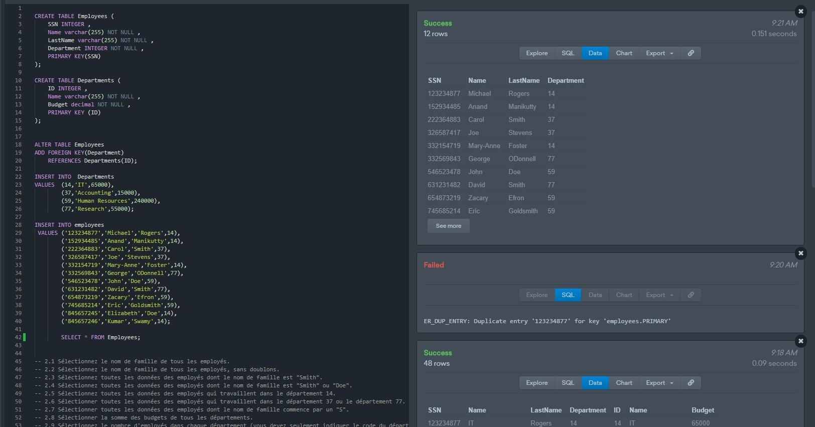
Création des tables

Slide 3
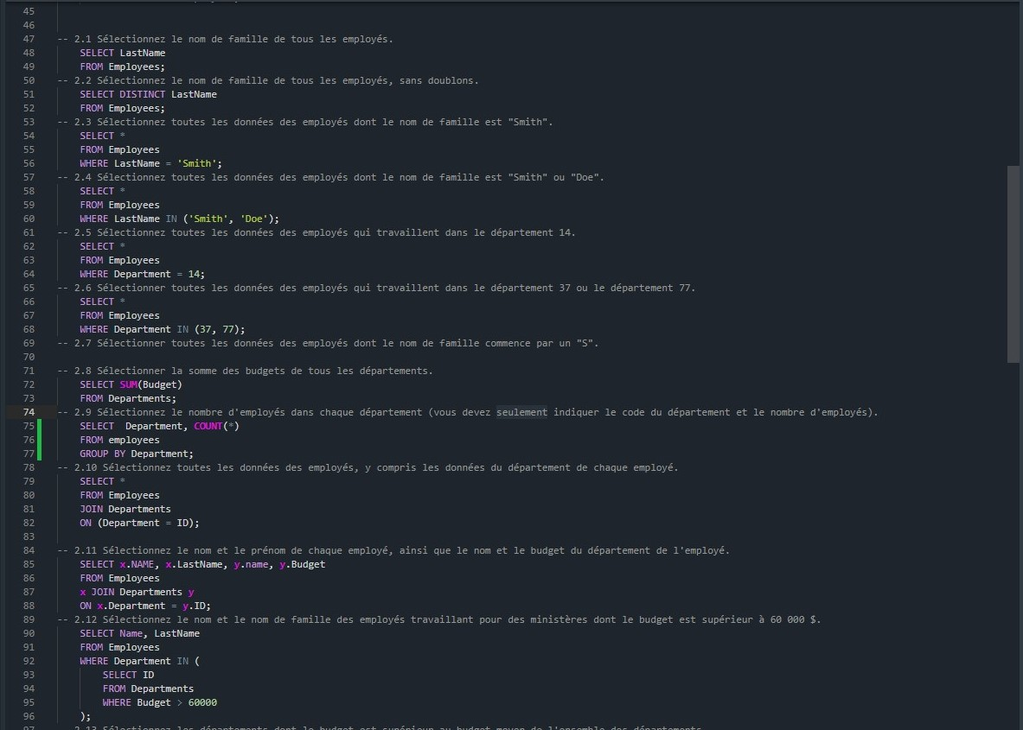
Questions From 1 Through 12.

Slide 4
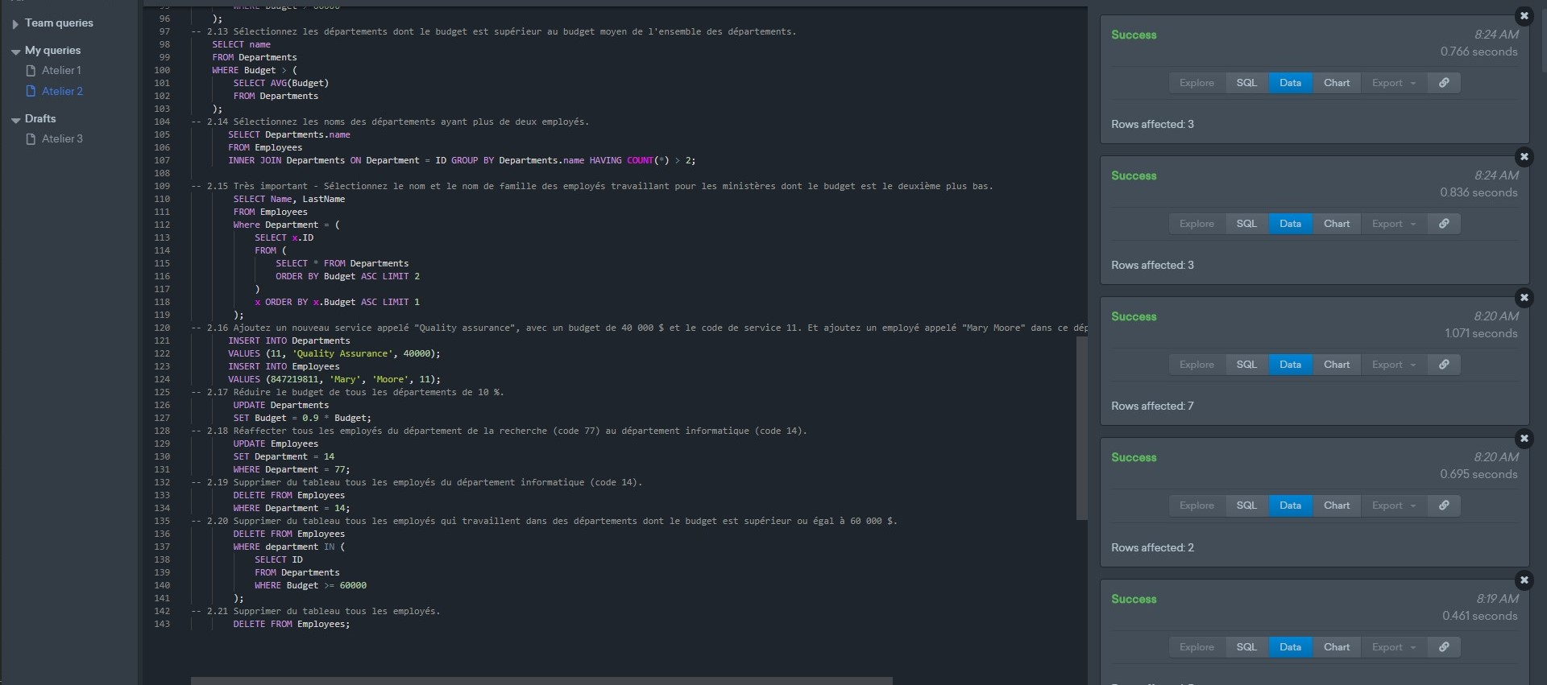
Questions From 13 Through 21.

